Slide 1
Pinnacle Foods Wishbone Launch Bottle Floorstand
March 2016 Display of the Month Submission

Slide 2
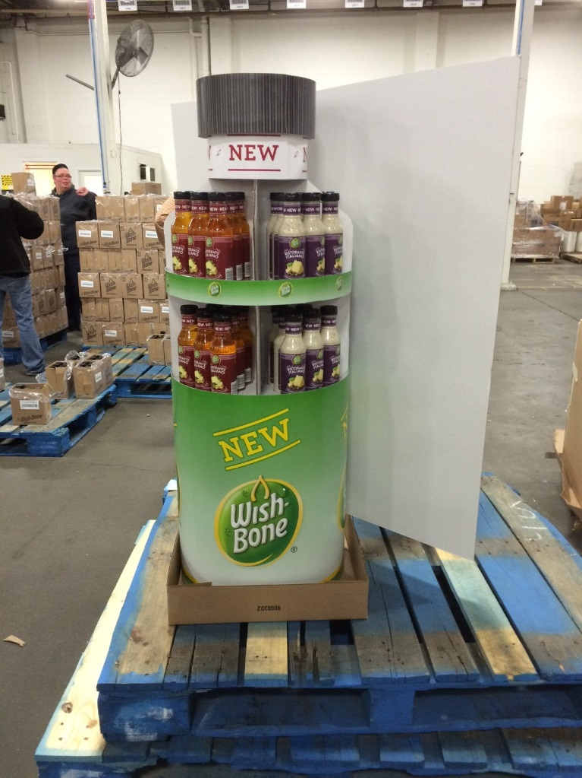
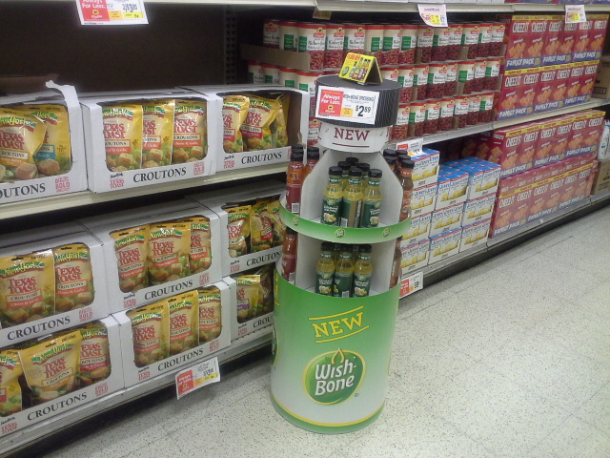
Pinnacle Foods Wishbone Launch Bottle Floorstand

Slide 3
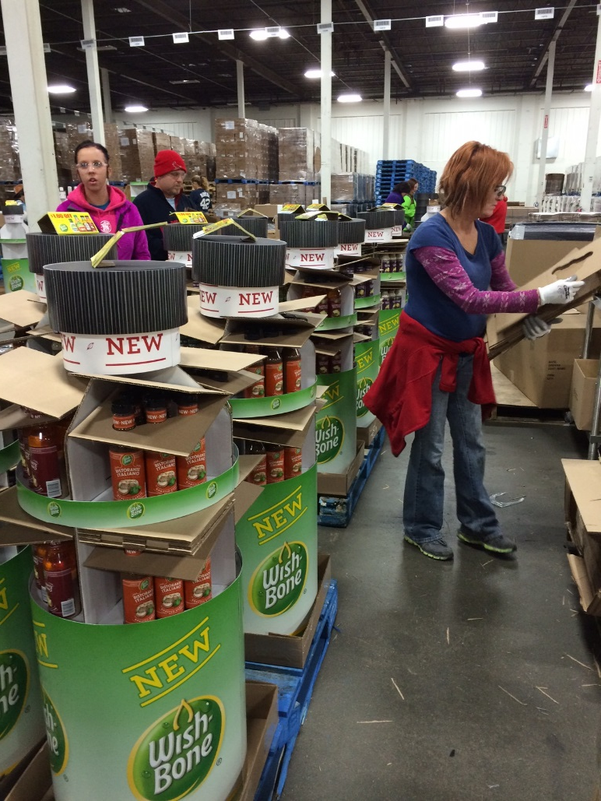

Slide 4
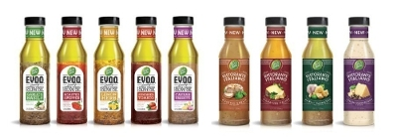
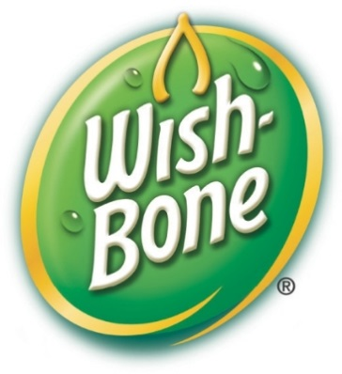
Objective:
The objective was to create an eye-catching display vehicle for the Grocery channel to support the launch of (2) new product lines under the Wishbone salad dressing brand. Display needs to communicate the launch and promote trial purchases
Wish-Bone E.V.O.O. dressings combine the goodness of extra virgin olive oil with Wish-Bone's signature blend of vinegars and spices.
Wish-Bone Ristorante Italiano dressings showcase varieties inspired by the most popular flavors served at leading Italian restaurants.

Slide 5
Objective:
The Solution: Created an engaging, functional floorstand that leverages the new product packaging. We mimicked the new bottle shape in a larger than life display. The graphics were developed to compliment both product lines and communicate the exciting launch from the Iconic Wishbone brand.

Slide 6
Insights:
What makes the display different: The display has a very premium look compared to typical grocery displays. The display is pre-packed with product and is fully assembled. The design makes setting-up at store level effortless. The larger than life look has stopping power to quickly engage the shopper calling attention to the new product
What is the clear compelling message: The display screams new product and uses brand equity to educate the shopper

Slide 7
Insights:
How does the display command attention: The use of the bottle shape in such a larger than life size helps initiate the shopper to engage with the product. The different shelf areas help separate and feature the different new flavor.

Slide 8
Instore Life Cycle:
What is the project duration of the display In store: Intended life of the display is 15 to 30 days. This display started to ship early February in sync with the product launch
Quantity: 15,000- first run

