Slide 1
Great Northern Corporation Twin Cities
March Instore Excellence Submission
Royal Canin “Spinner” Display

Slide 2
Project Overview
1224 Displays
Royal Canin specializes in breed-specific nutrition and challenged us with a way to communicate the specific needs of the seven major “small” breeds to the consumer. The owners of these breeds tend to be very “breed loyal.” Insights on what was important to the owners of these breeds was used to determine all of the messaging.
They desired simple “interactivity” and a way to convey the “premium” nutrition that Royal Canin offers.
The display had to ship with all of the product for the specific endcap, and also had to be completely setup so it could just be placed on the shelf.
The completely litho-printed display compelled attention from the shopper by featuring a very bright color scheme and lots of pictures of dogs. Which dog owners like (per Royal Canin). The interactivity (see next page) invited the shopper to explore for education.
The simple message was “why is custom nutrition important to your particular dog’s breed.”

Slide 3
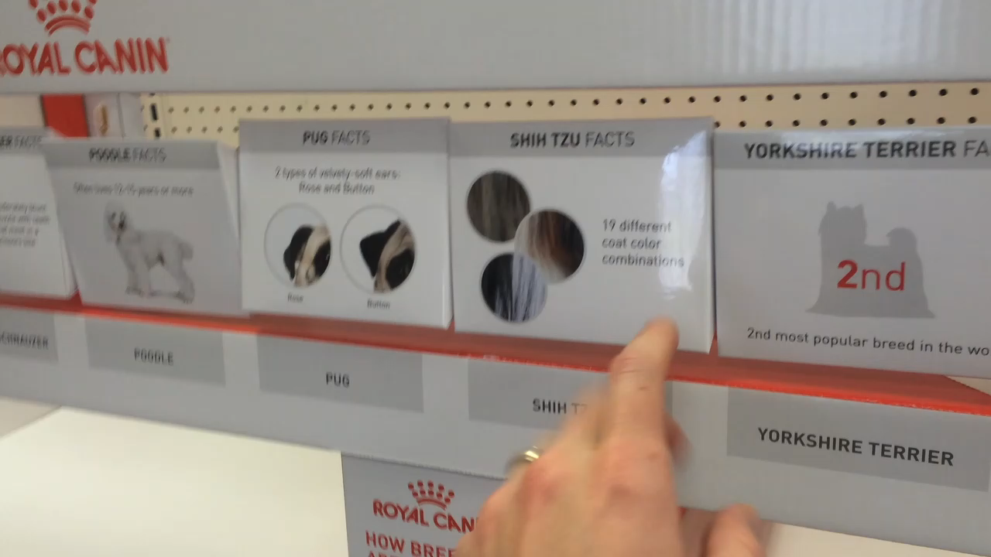
Interactivity
By utilizing this spinner, with high quality printed, polycoated triangular boxes for each breed, the shopper is able to get the sense that Royal Canin caters to their dog breed.

