Slide 1
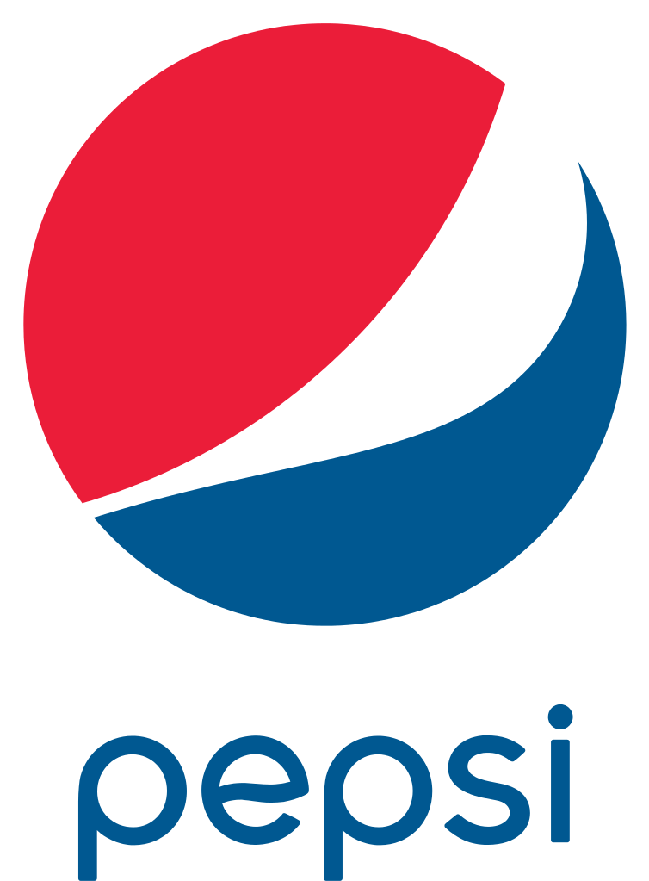
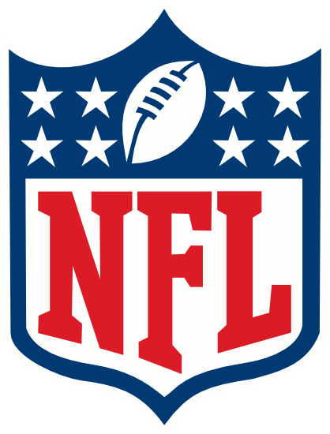
+
ARE YOU READY FOR SOME FOOTBALL …. OR ???

Slide 2
Objective/Solution
The objective was to develop a solution that would eliminate the time consuming task of building large format in-store (actual) product stack promotions, while maintaining the visual impact of these creative executions. The initial challenge was to develop an “Emoji” configuration, but Pepsi redirected us to an “NFL” aesthetic.
Solution (Pepsi “NFL” Product Wall): A corrugate (freestanding) two sided wall “dressed” w/ stacked product imagery (litho mounted components) is the main building block for this spectacular product representation. By design, the entire wall is slotted to receive lugged components of various sizes and complexities (details that further replicate the actual case promotions found at retail).
All “real”product is for sale. Nothing is sacrificed for the wall build…again all corrugate construction.
Lightweight and easily installed structure eliminates all safety issues, as this system is built from the floor up (w/o the use of ladders).
Easily updated w/ new lugs.

Slide 3
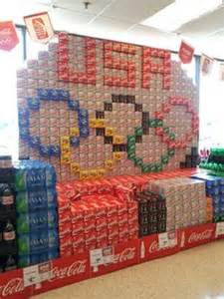
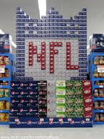
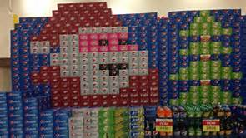
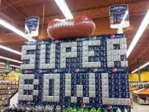
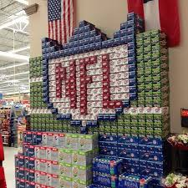
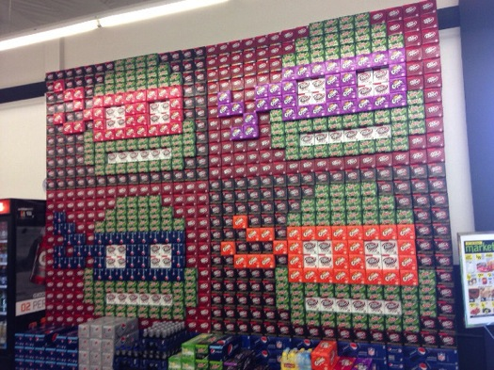
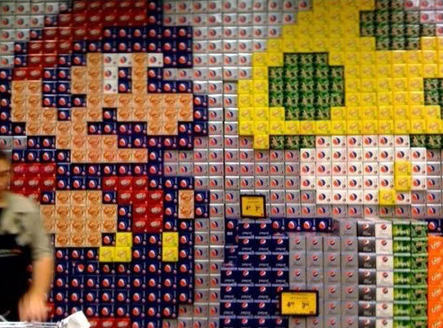
Store Audit Imagery
Various in-store promotions built with
actual fridgemate packaging.

Slide 4
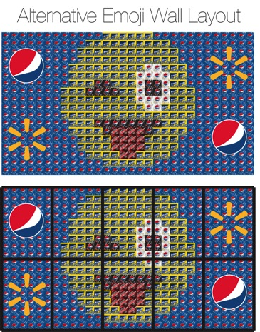
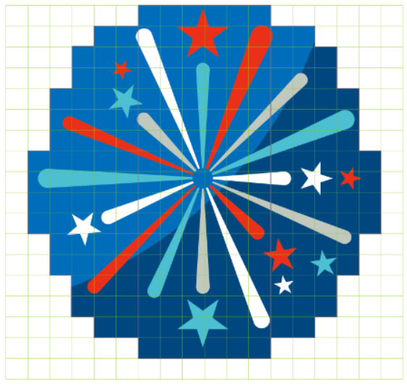
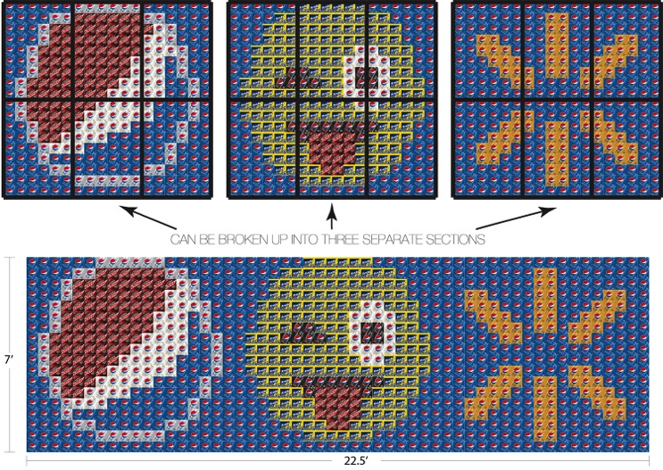
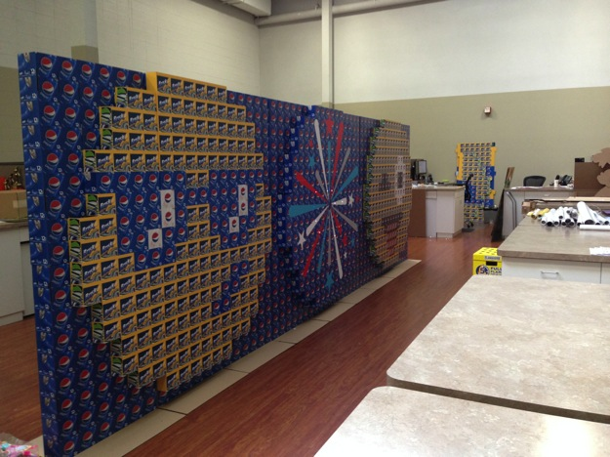
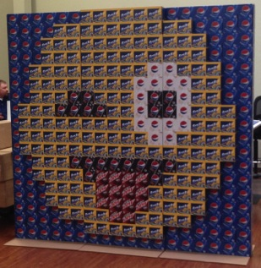
Development
Initial 2D & mocked concepts for the Emoji program. Ultimately, Pepsi abandoned its use for the launch and redirected us to develop a structure for the NFL and other seasonal promotions.
This structure included LED’s in the firework burst.

Slide 5
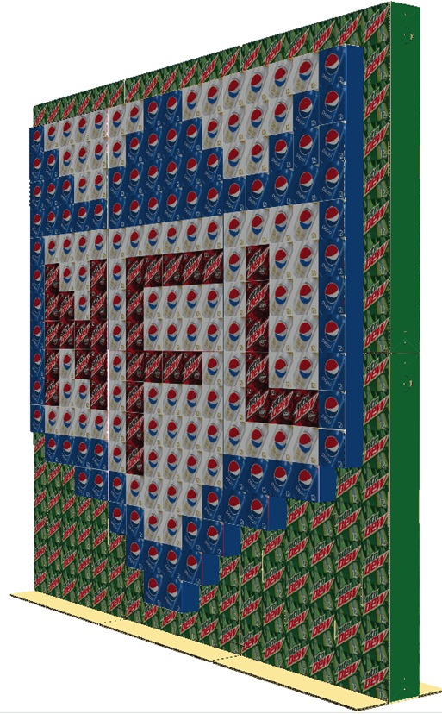
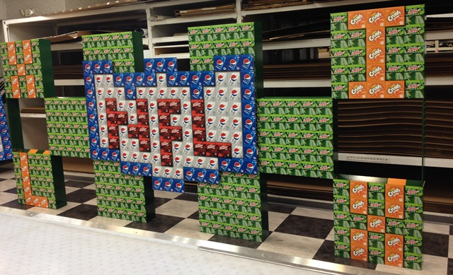
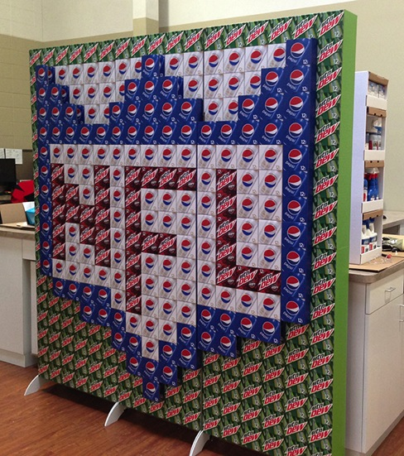
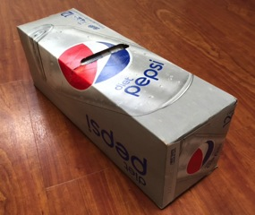
Development
Design exploration that included a “checkerboard” structure (above) and
styrene “feet” (shown on far right).
Actual “fridgemate” packaging typically utilized in “wall” constructions.

Slide 6
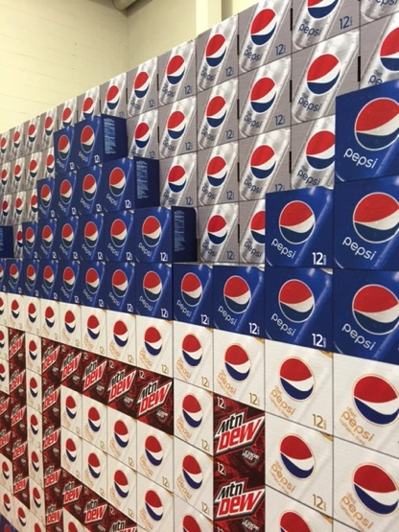
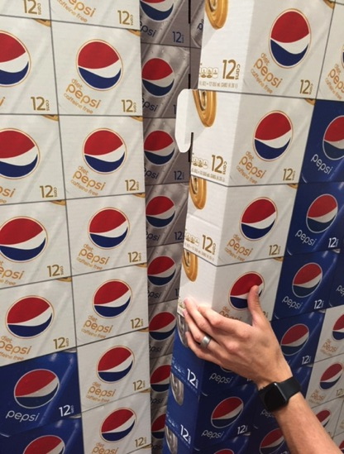
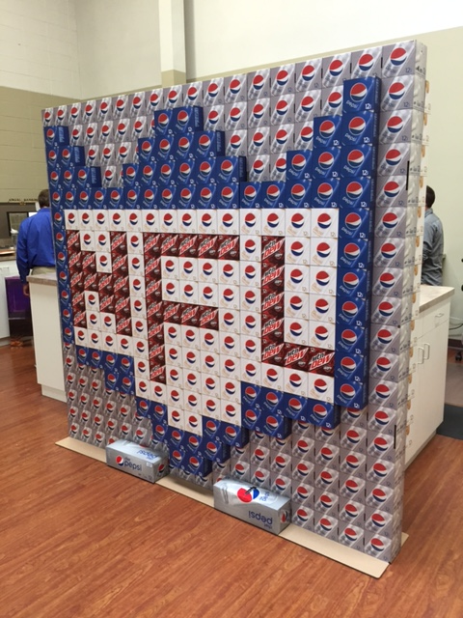
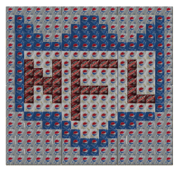
Solution
Dimensional lug tabs into back wall
Wall structure utilizes an “NFL” shield lug on each side

Slide 7
Details
What makes this merchandising solution different? This structure is cost effective, versatile and executes safely in minutes vs. the utilization of “live” product packaging. It also creates the ultimate “disruptive” promotional vehicle and a blank slate for unlimited creative layouts that would be impossible to replicate w/ actual product.
Most importantly, it’s the first execution of its kind in the POS industry!!!!!
Litho mounted corrugate construction (back wall & lugged elements)
Display structure assembles in minutes vs. hours for complex builds utilizing “real” product
Safe assembly from the floor – no tools are required
Small footprint (front to back).
Actual product (packaging) creates the needed ballast to support structure
Easily updated w/ new lugs, which extends its in-store life
Overall size: 7’H x 7.5’W x 5”D (lugs on each side add an additional 10” of depth)

Slide 8
Insights
What is the compelling message: This unit was specifically designed to promote Pepsi and the upcoming football season. The NFL shield is an all encompassing/iconic visual that is easily placed into any region/retailer w/o being team specific. Four Pepsi brands were utilized in the layout to create a powerful and vibrant visual that is hard to miss in the retail setting.
How do the displays command attention? SCALE. The wall size was specifically configured to fit into any retail setting, plus it is adaptable to an unlimited number of promotions!
Results: Units are just entering retail. Retailers are exited about this new tool for promoting Pepsi brands and the upcoming NFL season. A second order has been executed for the Chicago market that showcases the Cubs winning “W” lugged off of the product wall!

Slide 9
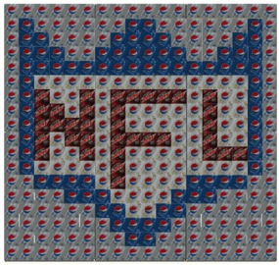
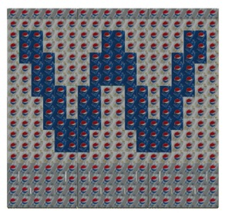
Instore Lifespan & Quantity
What is the lifespan of the in-store promotion: Up to 6 - 8 months (designed to be updated multiple times with other thematic/seasonal lugs).
Note: Soft drinks have a relatively short shelf life. Changes in taste and carbonation can occur after 12 weeks. Products utilized in long promotions are discarded. Our 3D wall solution eliminates this issue.
Production Quantities: 1000 “NFL” units. 200 additional units were produced for the Chicago market (utilizing a “W” lug).

